Slide 1
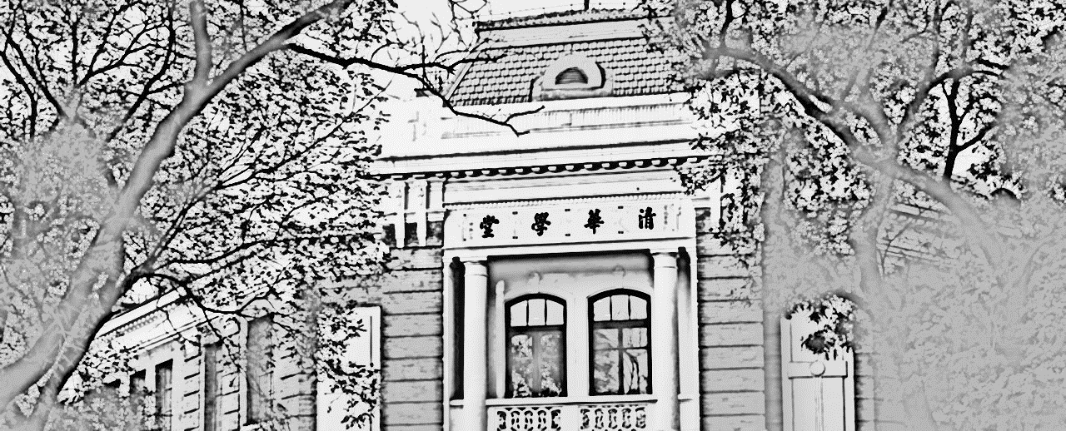

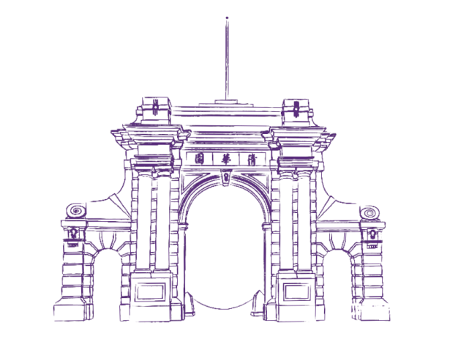
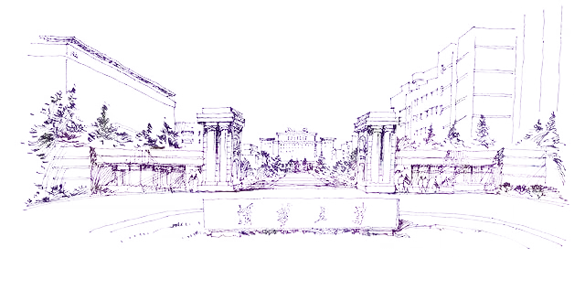


Inter-prediction for Multiview Video Coding
——Combing Spatial & Temporal Difference
王 萧 诚 : Basic Model, Segmentation, Improved model, Report & Slides, Code Optimization
欧阳湘凯: Deviation Correction, Improved Model,
Slides & Report, Further Improvement
12/21/2019
Intelligent Robotics Lab, Shenzhen International Graduate School, Tsinghua University

Slide 2
Contents
1
Project Introduction
2
Problem Analysis & Modeling
3
Results Evaluation & Analysis
4
Conclusions & Further Discussion

Slide 3
1. Project Introduction
Shenzhen International Graduate School, Tsinghua University

Slide 4
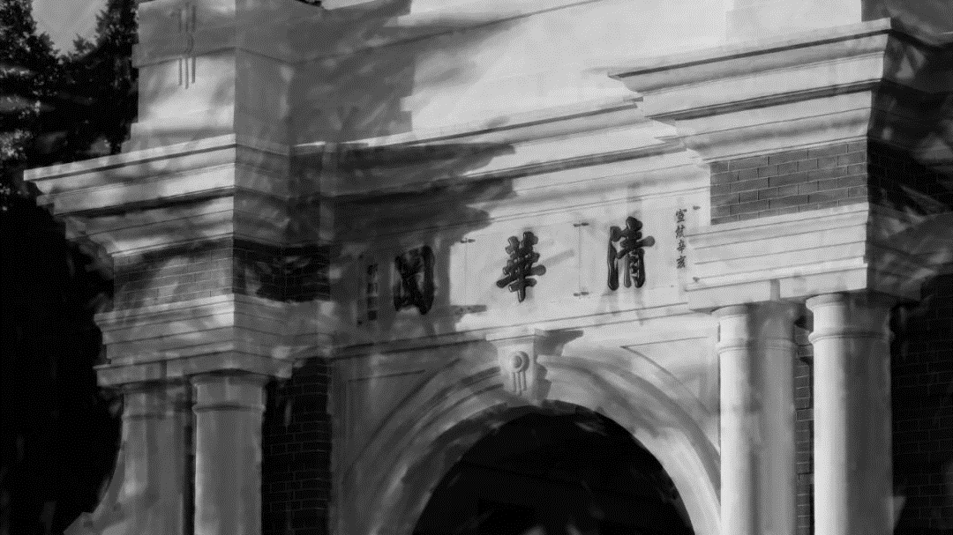

Project Introduction
Background
Problem Description
With the increasing demand for 3D vide and the advance of multi-media and camera technologies, multi-view video coding attracts more and more attention.
Practical applications such as VR, 3D re-construction and object motion estimation have promising prospects.
Given 7 datasets
18 images in one dataset, captured by 9 cameras in two frames.
We need to predict the center image of frame 2, with other 17 images available for reference.
We need to optimize in blocks and block size can be 4×4， 8×8， 16×16， 32×32 or 64×64.
We need to compute the average PSNR of seven datasets.
……

Slide 5
2. Problem Analysis & Modeling
Shenzhen International Graduate School, Tsinghua University

Slide 6
Problem Analysis & Modeling
Datasets analysis
boys moving
Dataset | Difference analysis
NagoyaOrigami | Almost no change
NagoyaDataLeading | Almost no change
NagoyaFujita | The green mat spinning clockwise a little
Cam_Still | The right knight moving right a little
Toys | The red car moving right a little
Trees | The whole scene moving right a little
Boys | Both boys moving arms a lot
Boys
car moving slightly
Toys
[row, col] = size(Img)
if mod(row, block_size) != 0
row_add = block_size – mod(row, blocksize)
else
row_add = 0;
if mod(col, block_size) != 0
col_add = block_size – mod(col, blocksize)
else
col_add = 0;
Img(row+1 : row+row_add, :, :) = 0
Img(:, col+1 : col+col_add, :) = 0
Paddling algorithm
almost whole image moving
Trees

Slide 7
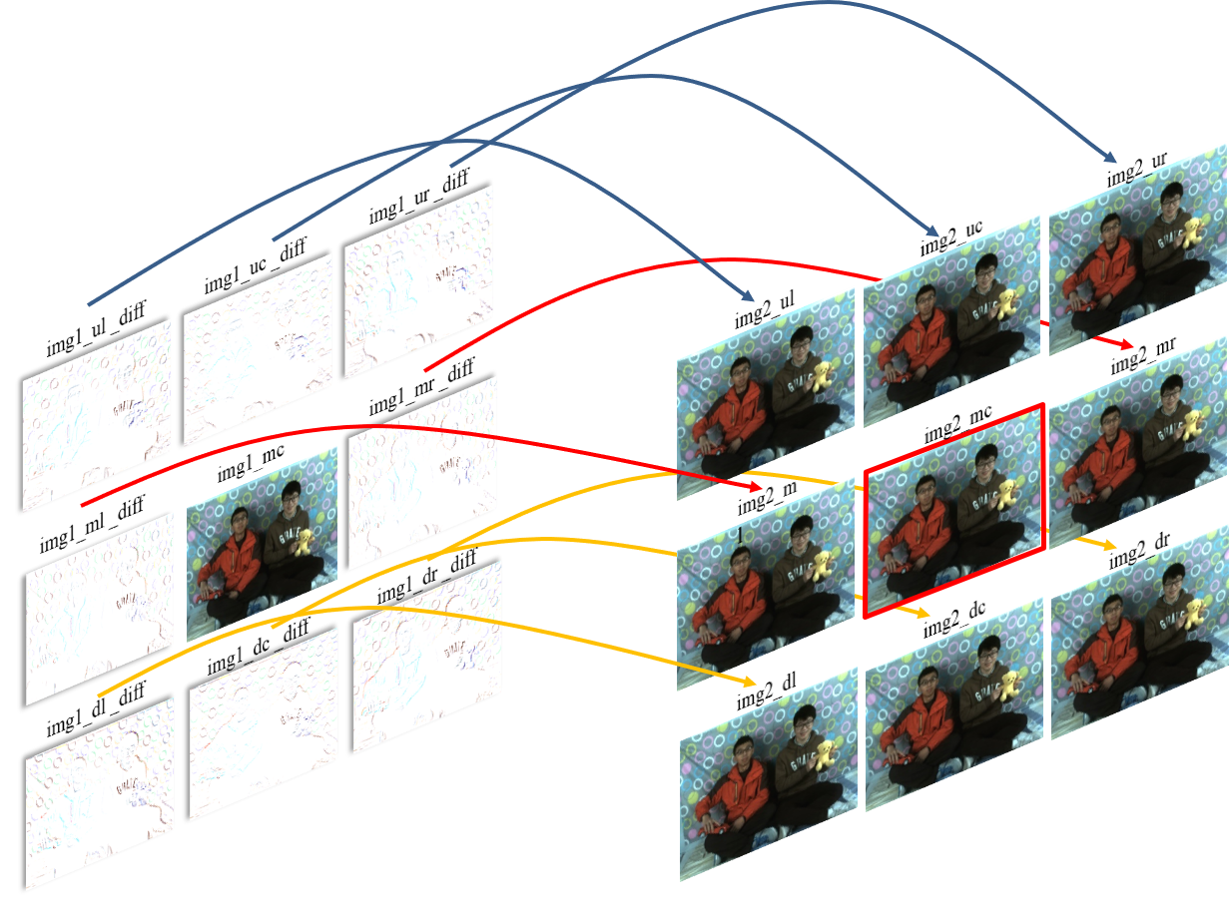
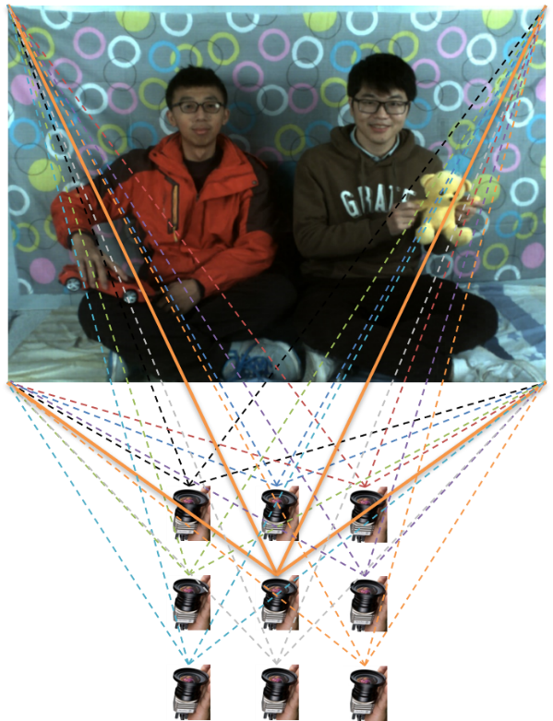
Problem Analysis & Modeling
Basic model: Spatial Difference Model
Optimization model:
The principle of basic model
Calculate the differences between surrounding images with the center image in frame 1;
Add the differences to the corresponding images in frame 2;
Optimize the sum of Frobenius – norm distance of predicted image and images above.
Working principle of multi-camera

Slide 8
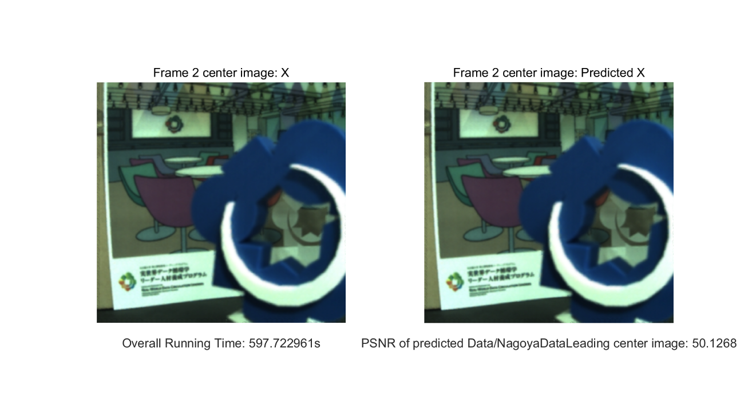
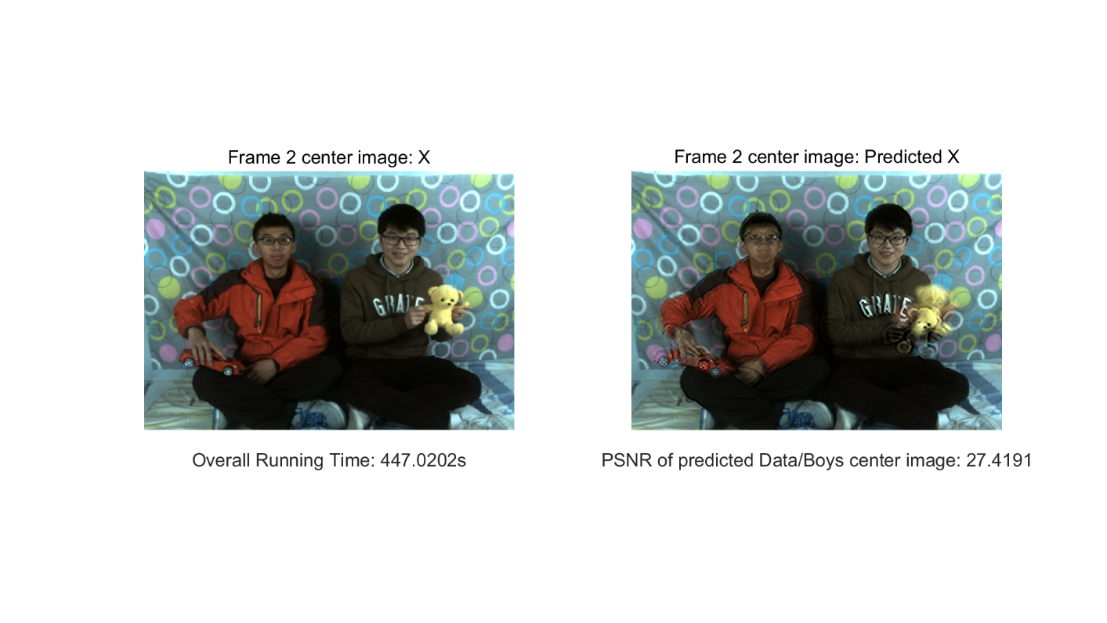
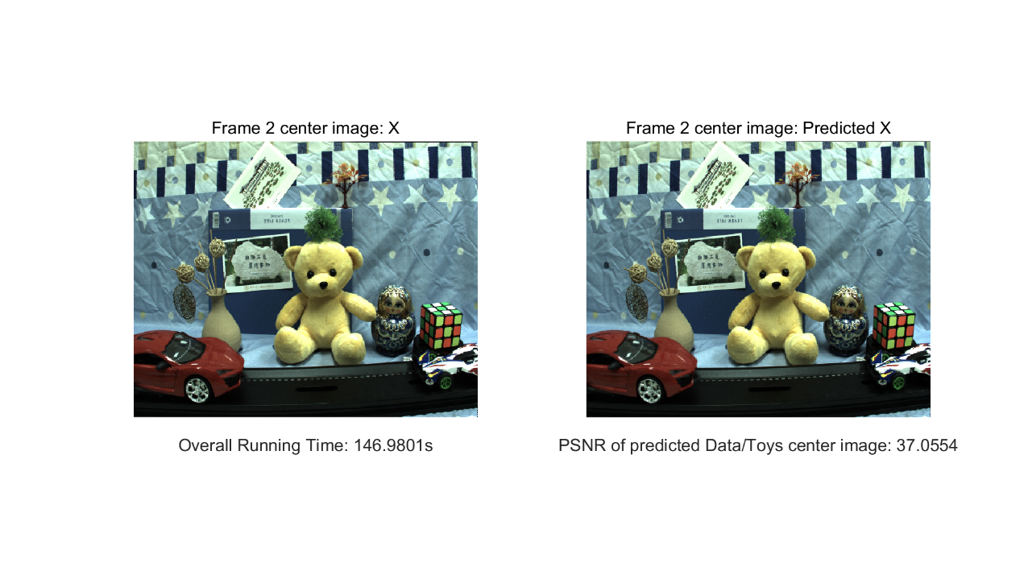
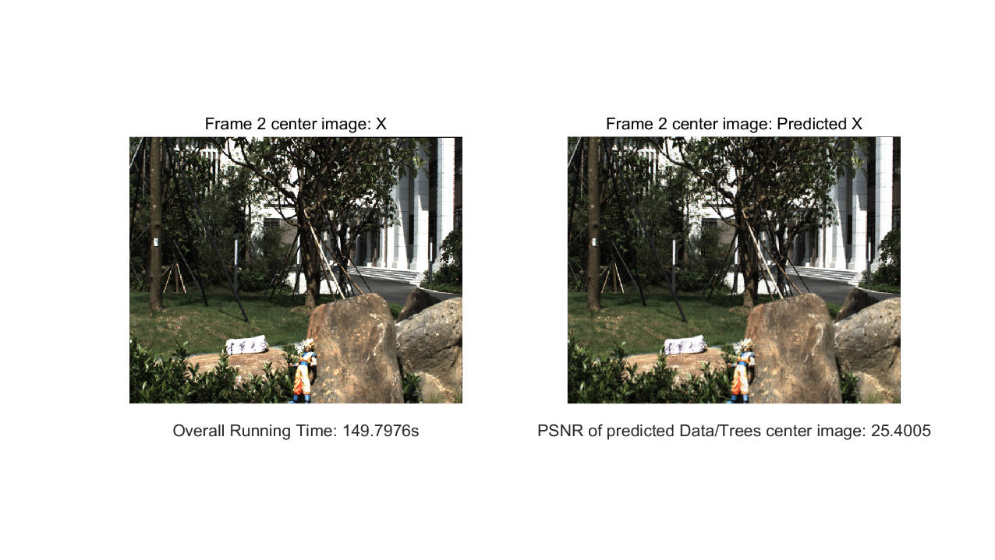
Problem Analysis & Modeling
Basic model: Spatial Difference Model
Moving objects distorted
NagoyaDataLeading
Boys
Have good results
Have unsatisfactory results
Toys
Trees

Slide 9
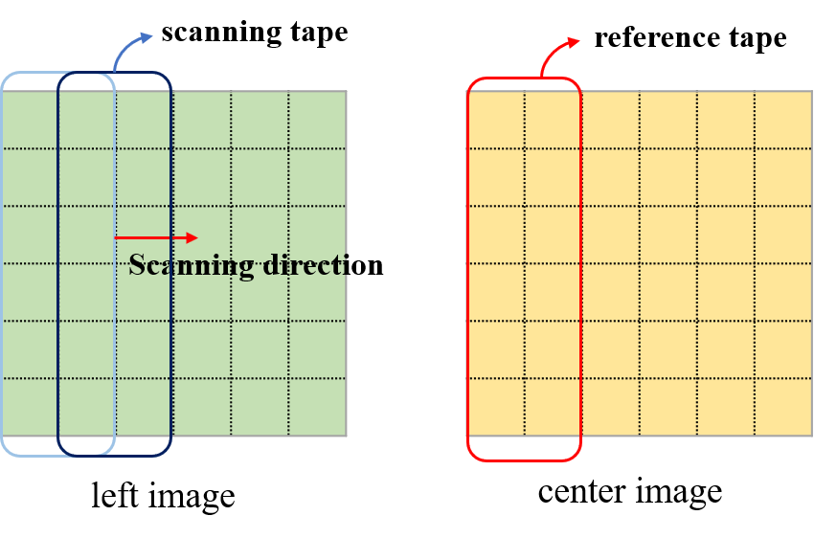
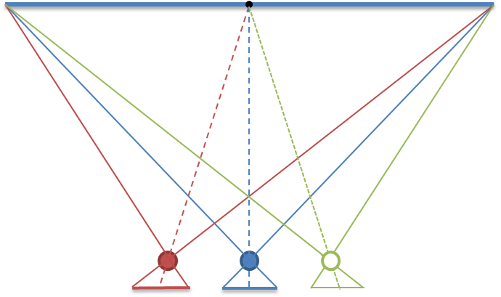
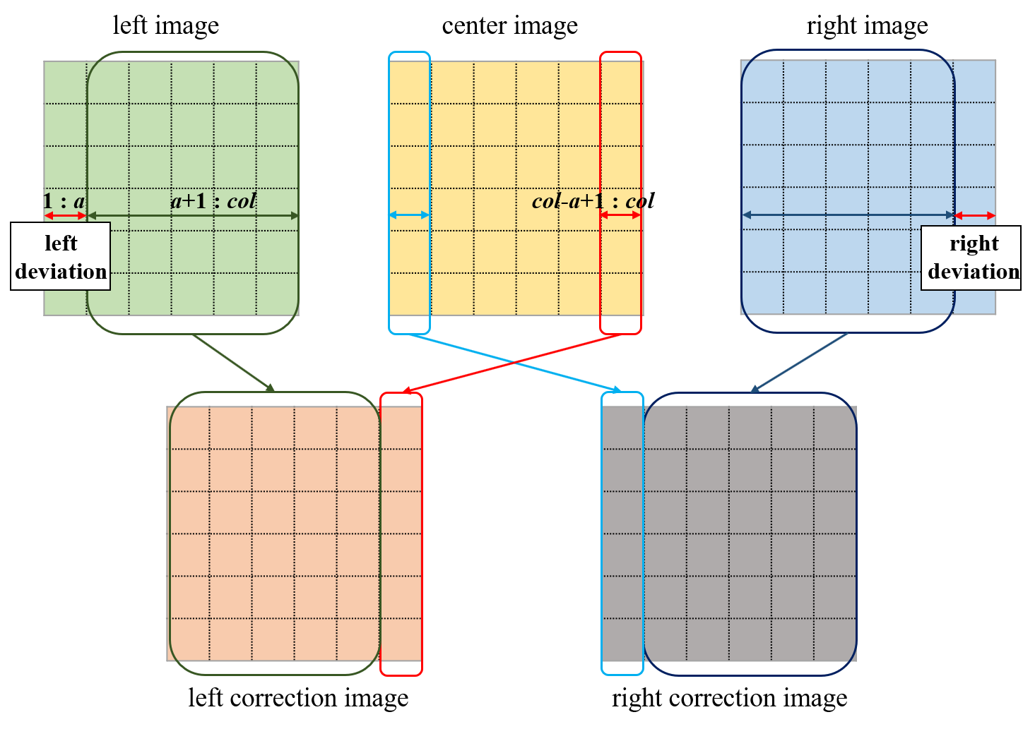
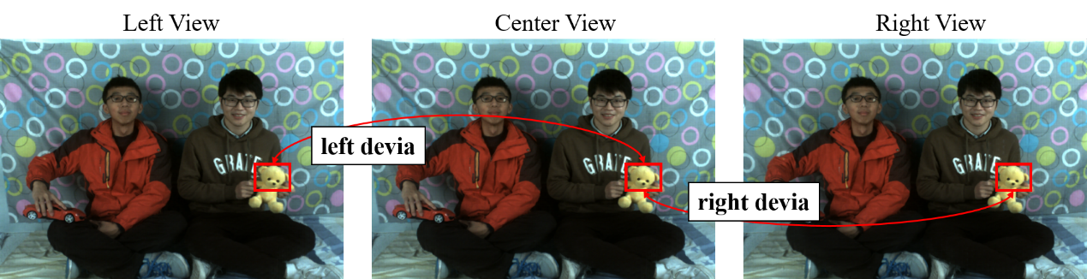
Problem Analysis & Modeling
Calculating the difference between reference and scanning tape.
Calculating the sum of the absolute values of the elements in each diff matrix.
The step with minimum sum is assumed as the deviation.
Deviation Correction
Scanning for deviation
Discarding the pixels which are at the deviated rows or columns.
The rest of pixels are shifted in the deviation direction.
Use the pixels in the center image to complete the rows or column
Camera position causes the disparity position of same object
As for the correction images in frame 2, we use the center image in frame 1 to complete them.
Correction schematic diagram

Slide 10
Problem Analysis & Modeling
Object Segmentation
Segmentation for Toys (block size = 64, 16, 4)
Spatial difference:
Temporal Difference:
function index = img_seg(img, box, threshold, num)
img = im2double(img);
index = zeros(size(img));
[row, col] = size(img);
index(find(img >= threshold)) = 1;
rowb = ceil(row/box);
colb = ceil(col/box);
for j = 1:colb
for i = 1:rowb
block = index(box * (i - 1) + 1:box * i, box * (j - 1) + 1:box * j);
if sum(sum(block)) >= num
index(box * (i - 1) + 1:box * i, box * (j - 1) + 1:box * j) = ones(size(block));
else
index(box * (i - 1) + 1:box * i, box * (j - 1) + 1:box * j) = zeros(size(block));
end
end
end
Segmentation for Boys (block size = 64, 16, 4)
Segmentation for Trees (block size = 64, 16, 4)
Segmentation algorithm

Slide 11
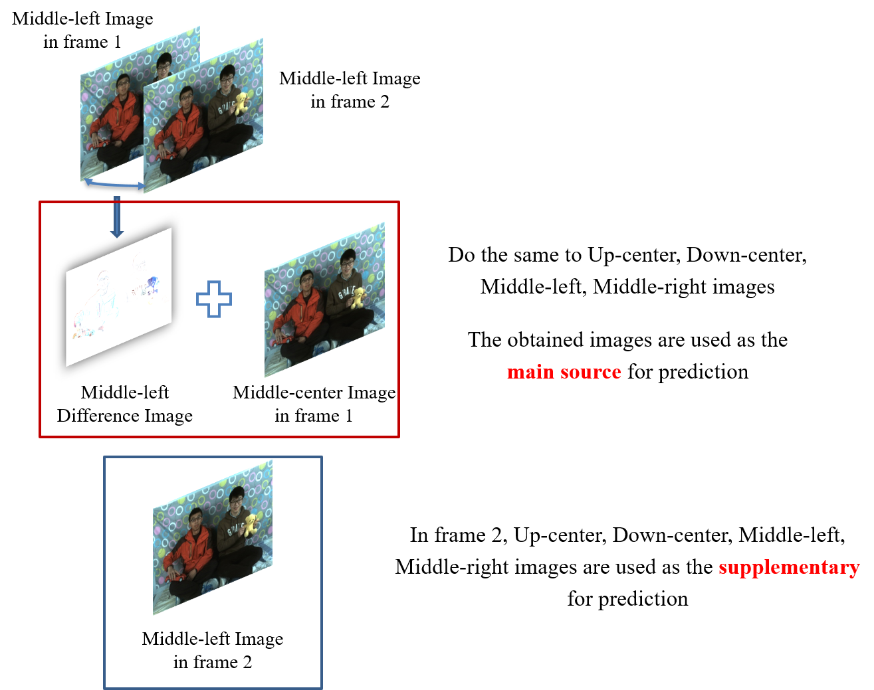
Problem Analysis & Modeling
Improved Model: Spatial & Temporal Difference Model
Changing parts (for moving objects)
Unchanging parts (for almost not moving objects)

Slide 12
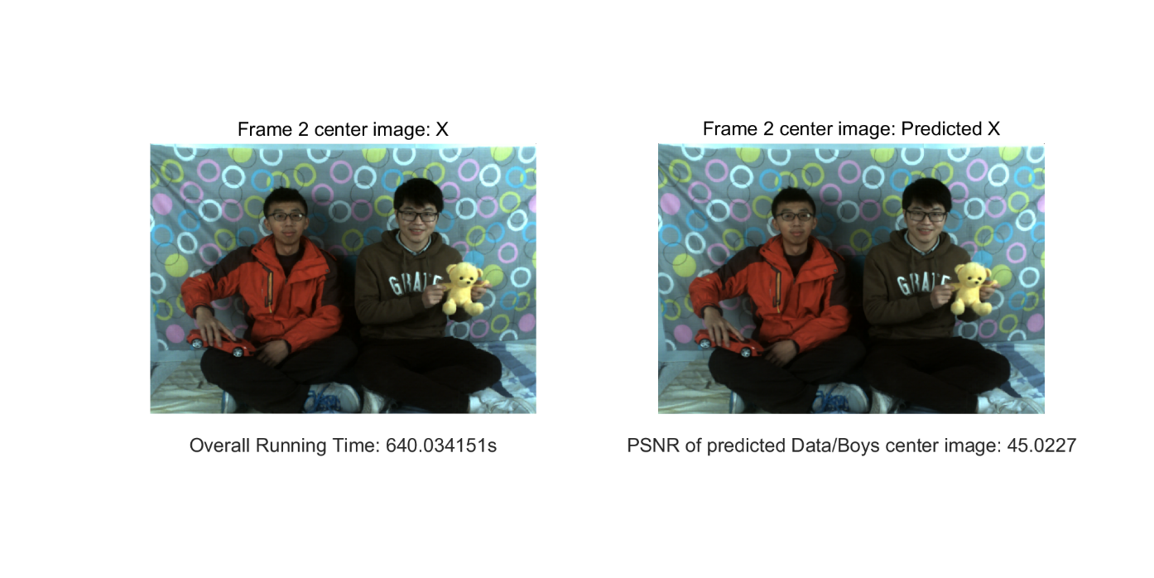
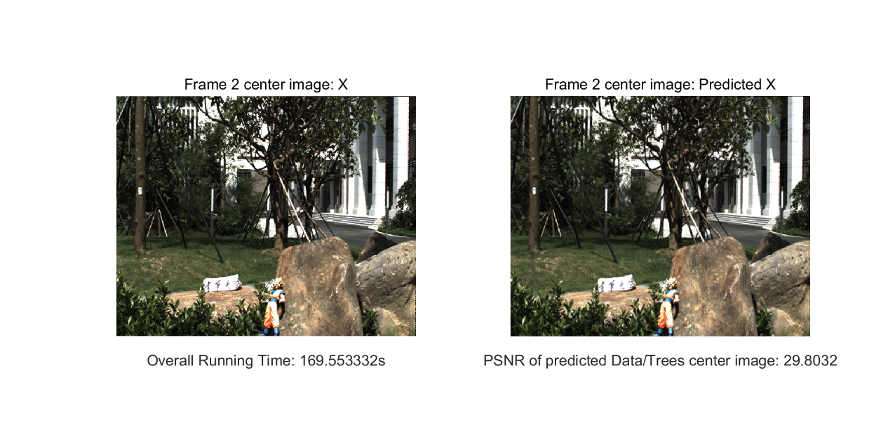
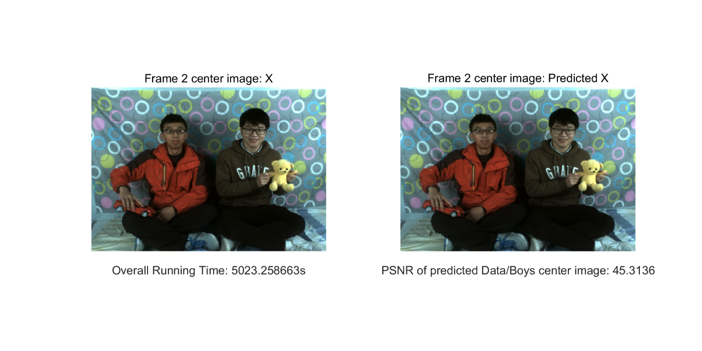

Problem Analysis & Modeling
Improved Model: Spatial & Temporal Difference Model
Boys （block size = 64）
Trees （block size = 64）
Moving objects predicted accurately
PSNR increased, but some details unsharp
Boys （block size = 16）
Trees （block size = 16）

Slide 13
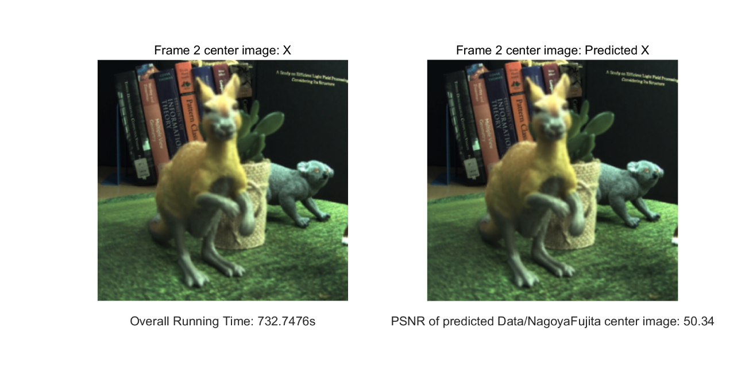
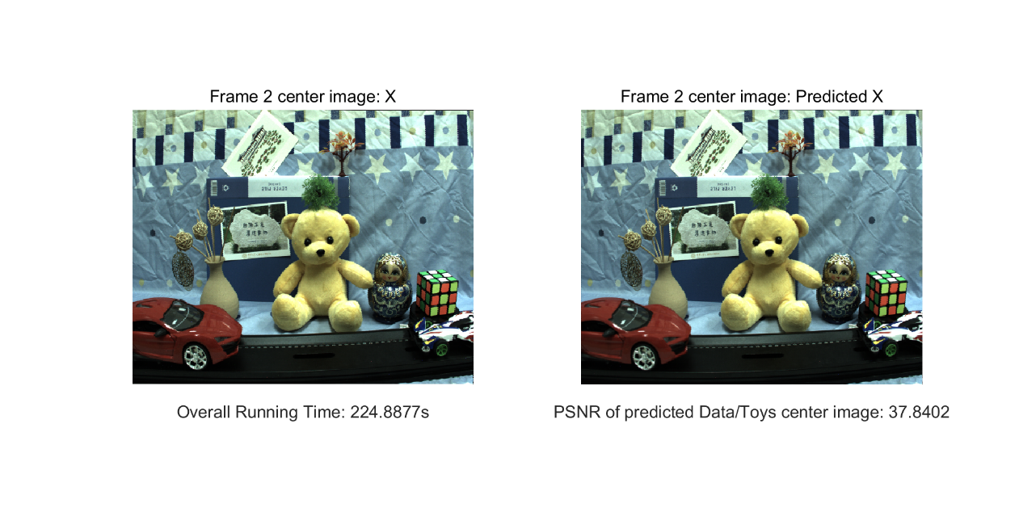


Problem Analysis & Modeling
Improved Model: Spatial & Temporal Difference Model
NagoyaFujita （block size = 64）
Toys （block size = 64）
Objects light, texture and other detail predicted more accurately
NagoyaFujita （block size = 16）
Toys （block size = 16）

Slide 14
3. Results Evaluation & Analysis
Shenzhen International Graduate School, Tsinghua University

Slide 15
Results Evaluation & Analysis
Comparison of PSNR
Comparison of Optimization Time
 | Basic model | Improved model
Block size | 64*64 | 64*64 | 16*16
NagoyaOrigami | 49.2185 | 49.9825 | 50.1948
NagoyaDataLeading | 50.1268 | 51.5658 | 51.8709
NagoyaFujita | 49.6233 | 50.3400 | 51.1653
Cam_Still | 40.5198 | 43.3257 | 43.7110
Toys | 37.0554 | 37.8402 | 38.0948
Trees | 25.4005 | 29.8032 | 30.0310
Boys | 27.4191 | 45.0227 | 45.3136
Average PSNR | 39.9091 | 43.9829 | 44.3402
 | Basic model | Improved model
Block size | 64*64 | 64*64 | 16*16
NagoyaOrigami | 467s | 742s | 4973s
NagoyaDataLeading | 598s | 741s | 4339s
NagoyaFujita | 567s | 733s | 5006s
Cam_Still | 1208s | 1594s | 12979s
Toys | 147s | 225s | 1289s
Trees | 150s | 170s | 1378s
Boys | 447s | 640s | 5023s
Compared with the basic method, the improved method improved the PSNR of all groups, especially in the Boys image, where the boys have a large apparent motion.
The PSNR has a small increment by using 16*16 block size, while the time spent on optimization has multiplied.

Slide 16
4. Conclusions & Further Discussion
Shenzhen International Graduate School, Tsinghua University

Slide 17
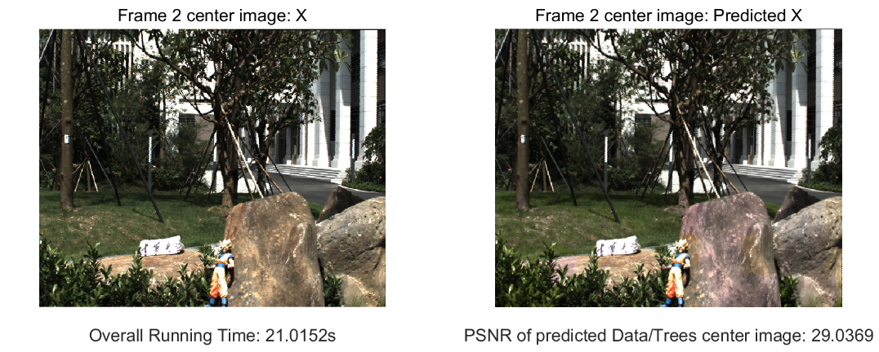
Conclusions & Further Discussion
Conclusions
Further Discussion
A basic Spatial Difference Model is proposed and evaluated.
Based on Deviation Correction & Object Segmentation, an improved Spatial & Temporal Difference Model is proposed and evaluated.
We believe our improved model can extract light and other environmental information to enhance the prediction performance.
Adaptive weights
Camera offset correction
Shear, rotation and other transformation
Evaluation of camera offset correction

Slide 18
Thanks for listening
12/21/2019

